Slide 1
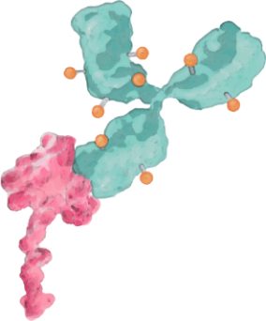
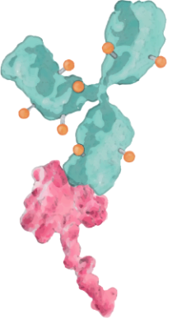
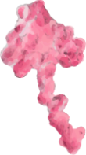
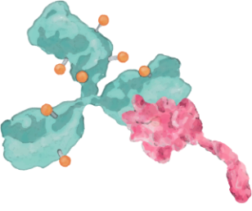
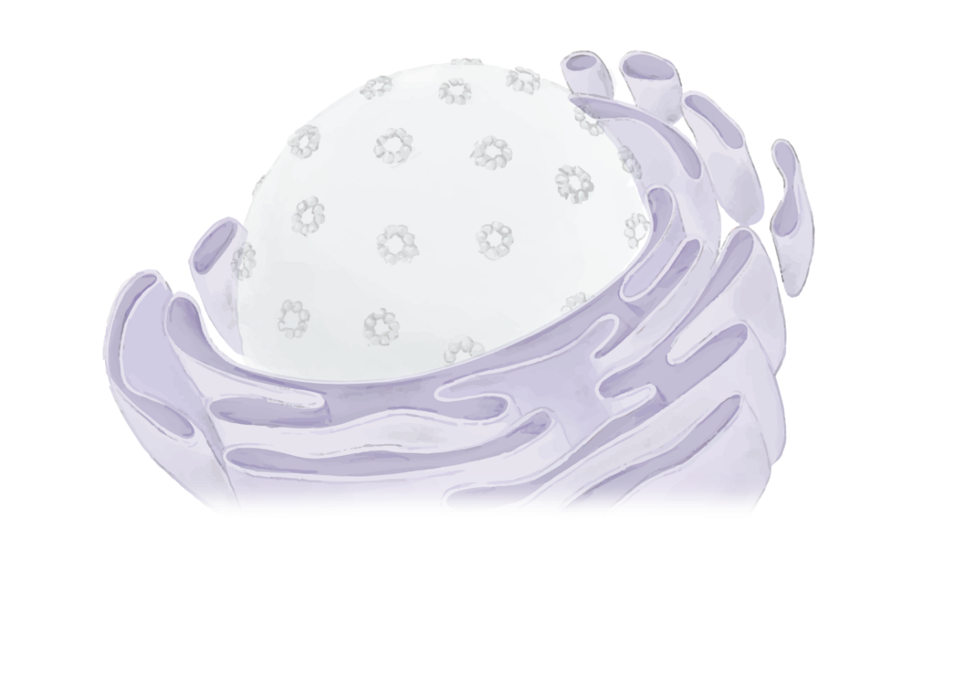
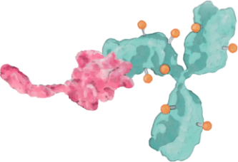
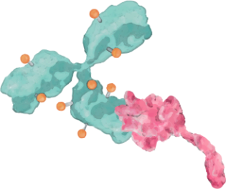
1
Binding
Internalization
Intracellular Trafficking
Lysosomal Degradation
Cell Cytotoxicity
*
Bystander Effect
Intracellular SN-38 release after internalization/DNA damage to targeted cell and bystander effect on adjacent tumor cells
2
**
*
3
Bystander Effect
Tumor cell
4
5
Trop-2
TOPO I
Trophoblast cell surface antigen 2 Type I topoisomerase
Sacituzumab govitecan
**
SN-38
1
Trop-2
2
TOPO I
5
Tumor cell
4
3
Endosome
pH
Lysosome
Adapted from Rugo et al., 2020.

