Slide 1
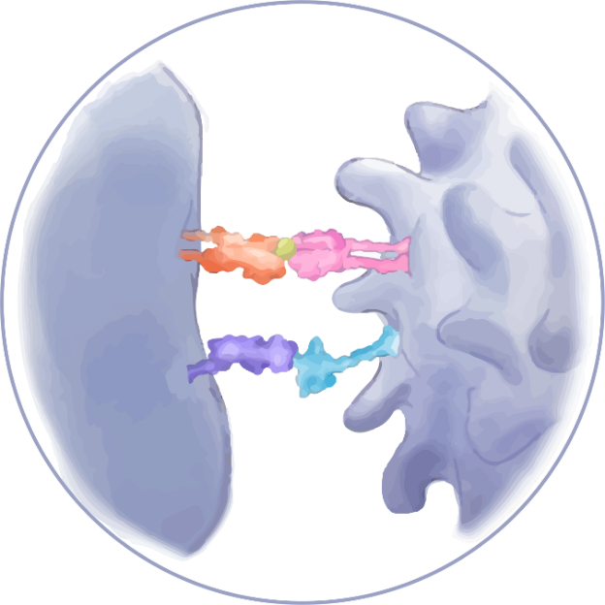
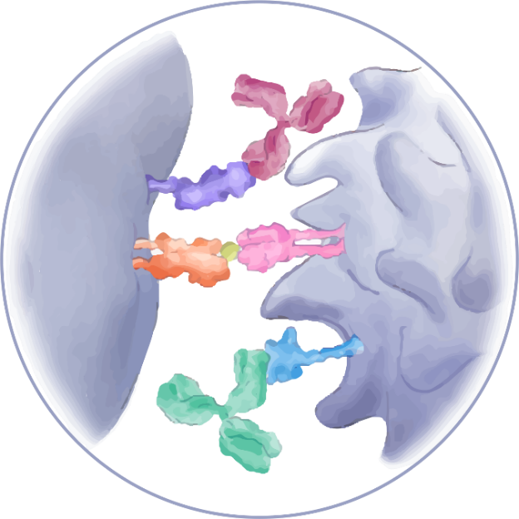
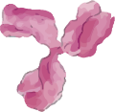
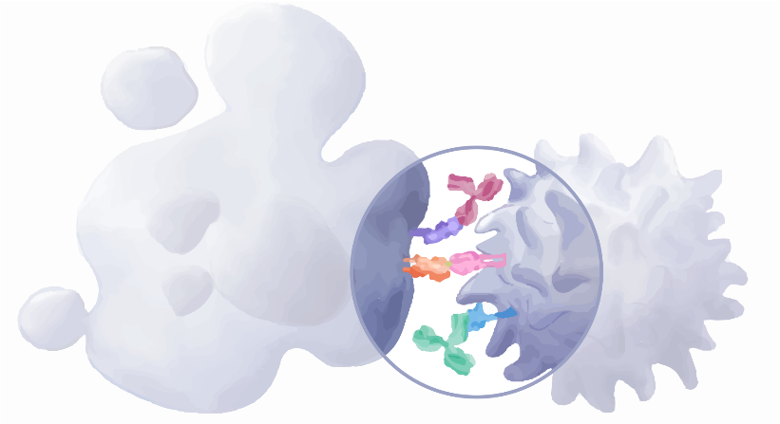
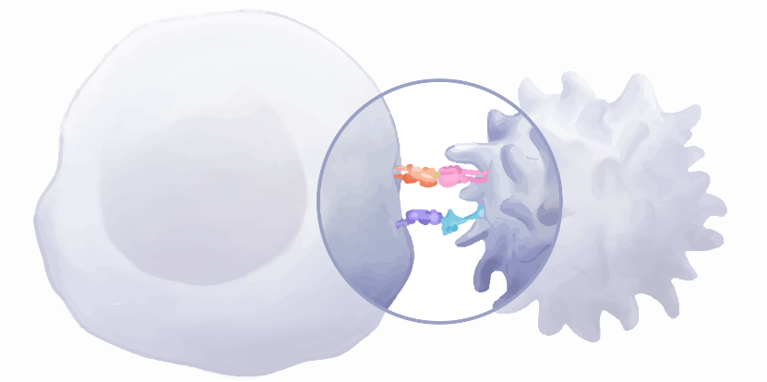
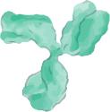
PD-L1 binds to PD-1 and inhibits T cell killing of tumor cell
Blocking PD-L1 or PD-1 allows T cell killing of tumor cell
Tumor cell
T cell
Cell death
anti-PD-L1 Ab
anti-PD1 Ab
TCR
MHC
PD-1
PD-L1
Antigen
Tumor cell
T cell
Tumor cell death
T cell
Adapted from Fernandez-Rozadilla et al. 2021. AT-UNB-0475

