Slide 1
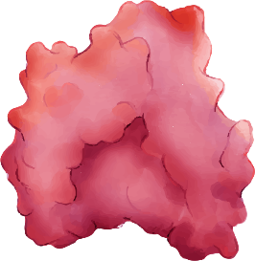
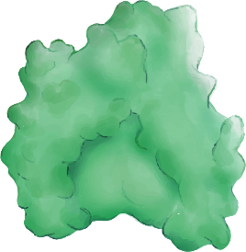
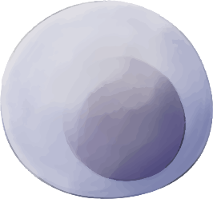
PARP
PARP
PARP inhibitors
Single-strand break (SSB)
Single-strand break (SSB)
SSB converted to Double-strand break (DSB)
Single-strand break repaired
Normal cell:
Repair by homologous recombination
BRCA-mutated cell:
No homologous recombination
No repair
Cell survival
Cell survival
Cell death
Adapted from Zheng et al., 2020. AT-UNB-0474

