Slide 1
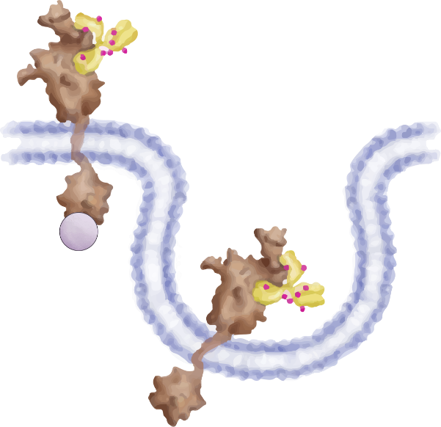
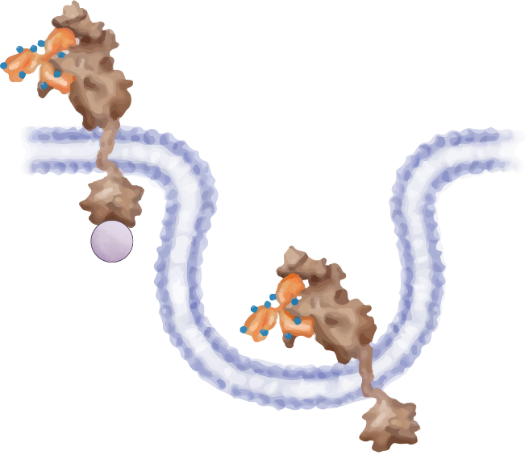
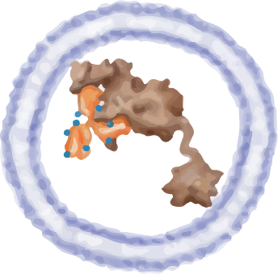
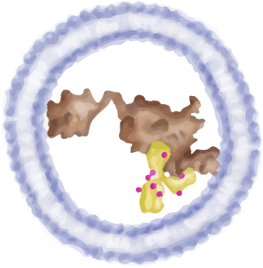
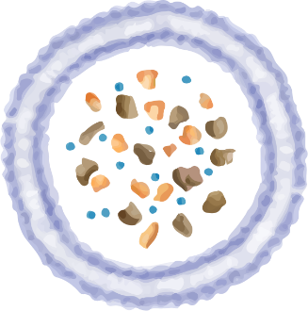
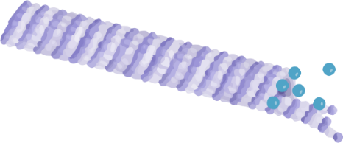
Trastuzumab
Pertuzumab
T-DXd
T-DM1
T-DXd
T-DM1
Trastuzumab deruxtecan
Trastuzumab emtansine
Margetuximab
HER2
HER2
HER2
HER2
extracellular
Lapatinib
Neratinib
Tucatinib
intracellular
P
P
P
P
PI3K
RAS
Endocytosis
AKT
RAF
mTOR
MEK
ERK
Lysosomal
degradation
Transcription
DXd
Topoisomerase I inhibition
Microtubule growth inhibition
nucleus
cytoplasm
DM1
Adapted from Gajria et al., 2011., Singh et al., 2014. AT-UNB-0473

