Slide 1
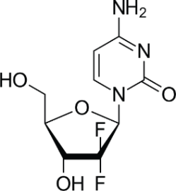
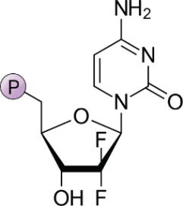
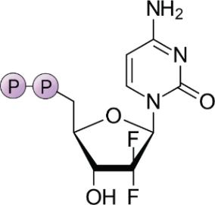
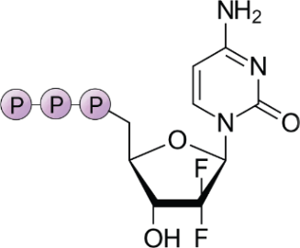
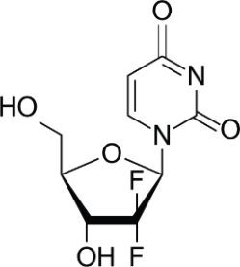
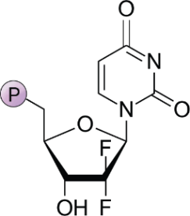
CDP
RR
dCDP
dCTP
Cell membrane
Gemcitabine/dFdC
DCK
NMPK
NDPK
dFdC
dFdCMP
dFdCDP
dFdCTP
DNA
synthesis
hNTs
dCMPF
deaminase
CDA
RNA
synthesis
dTMP
dTDP
dTTP
dFdU
dFdUMP
TS
dUMP
dFdU
DCK
NMPK
NDPK
CDA
hNTs
RR
dUMP
Deoxycytidine kinase
Nucleotidmonophosphatkinase
Nucleotiddiphosphatkinase
Cytidine deaminase
Nucleoside transporters
Ribonucleotide reductase
Deoxyuridine monophosphate
dTMP
dTDP
dTTP
dCDP
dCTP
dCMP
dFdU
Deoxythymidine monophosphate
Deoxythymidine diphosphate
Deoxythymidine triphosphate
Deoxycytidine diphosphate
Deoxycytidine triphosphate
Deoxycytidine monophosphate
2’,2’-Difluorodeoxyuridine
dFdC
dFdCMP
dFdCDP
dFdCTP
dFdUMP
Difluorodeoxycytidine/
Gemcitabine
Gemcitabine monophosphate
Gemcitabine diphosphate
Gemcitabine triphosphate
2’ 2’-Difluorodeoxyuridine
monophosphate
Extracellular
Intracellular
Adapted from Saiki et al., 2020.
AT-UNB-0472

