Slide 1
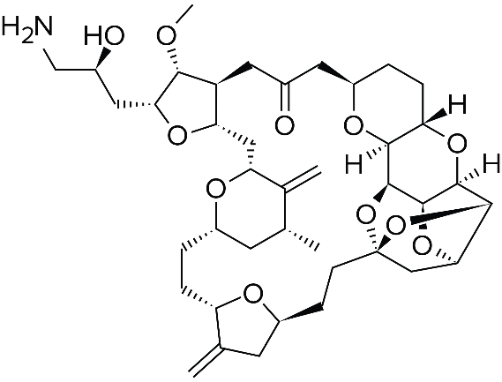
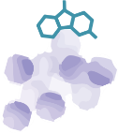
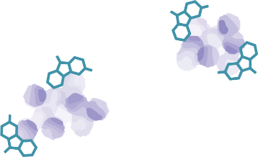
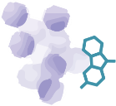
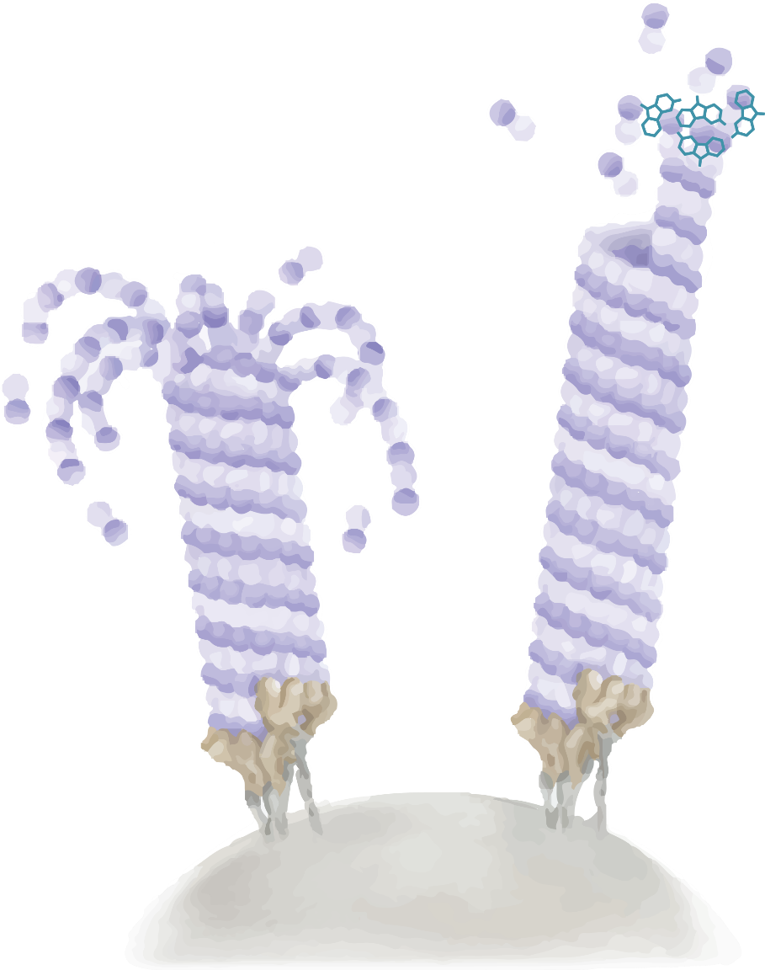
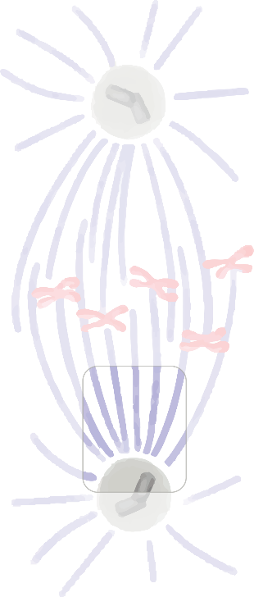
Tubulin
polymerization
Nonproductive tubulin aggregate formation
Tubulin
depolymerization
Eribulin suppresses microtubule polymerization
Eribulin sequesters tubulin into nonfunctional aggregates and thereby suppresses microtubule polymerization, resulting in:
Persistent mitotic arrest
Apoptosis induction
Eribulin has no significant effect on microtubule depolymerization
Shrinking microtubule
Growing microtubule
MTOC
(Spindle)
Adapted from Cortes et al., 2011. AT-UNB-0471

