Slide 1
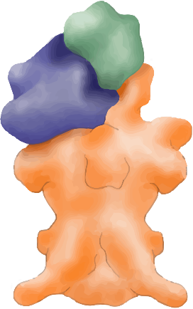
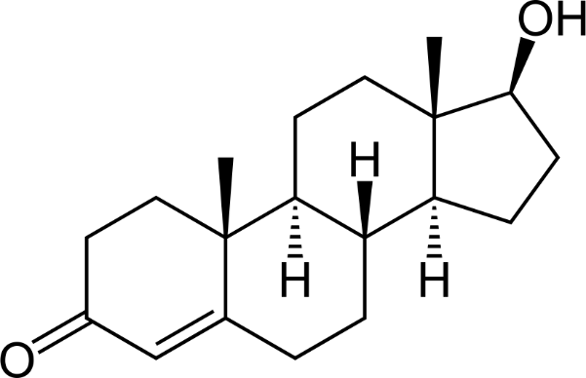
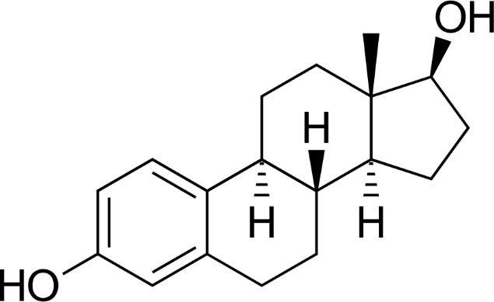
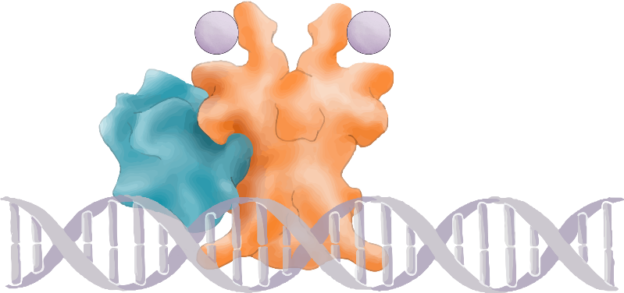
Postmenopausal
Coactivators & Cosuppressors
Aromatase inhibitors
Anastrozole
Letrozole
Exemestane
Selective ER degrader
Fulvestrant
Selective ER modulator
Tamoxifen
ER
ER
Dimerization
Aromatase
Androgens
Estrogens
ER
Phosphorylation & DNA binding
Receptor binding
P
P
ER
GnRH
FSH
LH
VEGF
Bcl-2
PR
Estrogen receptor
Gonadotropin releasing
hormone
Follicle stimulating hormone
Luteinizing hormone
Vascular endothelial
growth factor
B-cell lymphoma-2
Progesterone receptor
Premenopausal
ER-driven Transcription
CyclinD
c-myc
VEGF
Bcl-2
PR
GnRH agonists
Suppress pituitary FSH, LH and ovarian production
ER
ER
FOXA1
Adapted from Harold J Burstein, 2020. AT-UNB-0470

