Slide 1
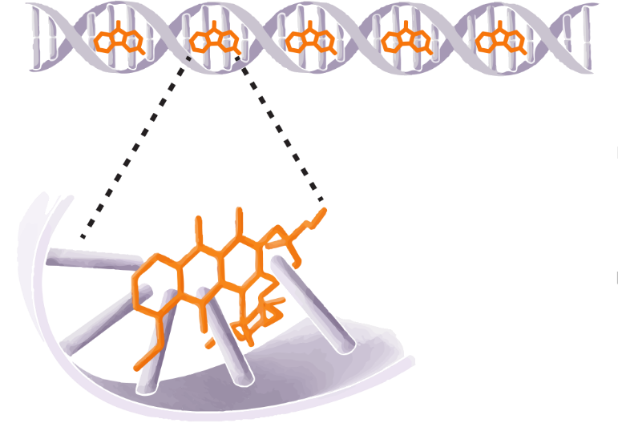
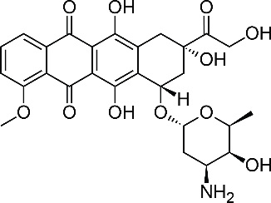
normal DNA
DNA-Doxorubicin Complex
Doxorubicin
TOP2B binding
Intercalation
Inhibition of TOP2 binding
DNA synthesis
Inhibition of DNA synthesis
Adapted from Mobaraki et al., 2017. AT-UNB-0469

