Slide 1
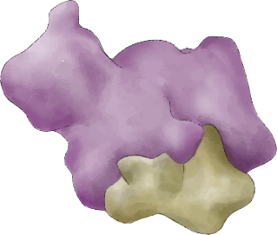
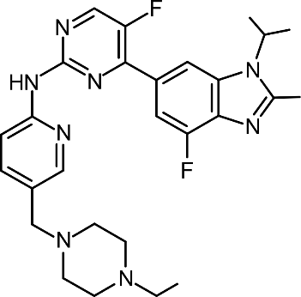
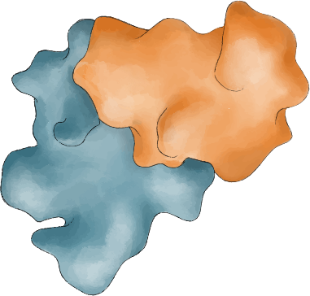
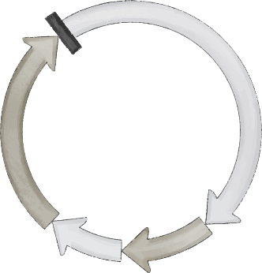
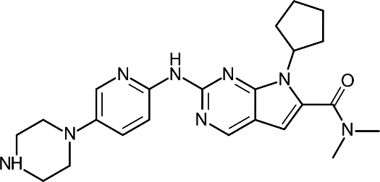
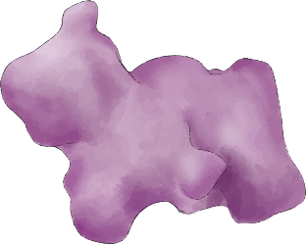
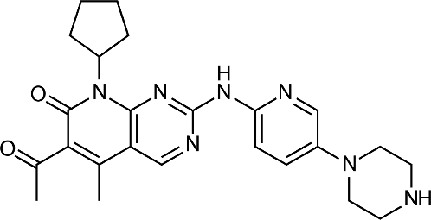
CDK4/6
inhibitors
Abemaciclib
E2F
Rb
G1-to-S checkpoint
CDK4/6
P
S
Ribociclib
Cyclin D
G1
P
Rb
M
G2
Palbociclib
Transcription
E2F
Adapted from Groenland et al., 2020. AT-UNB-0479

