Slide 1
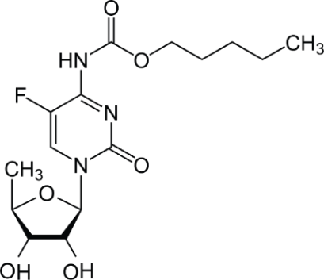
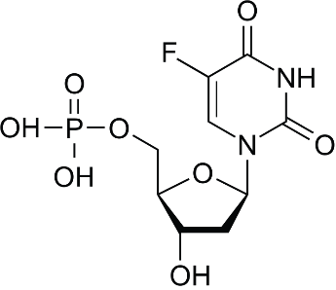
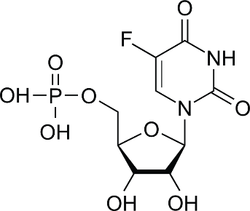
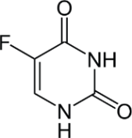
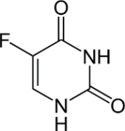
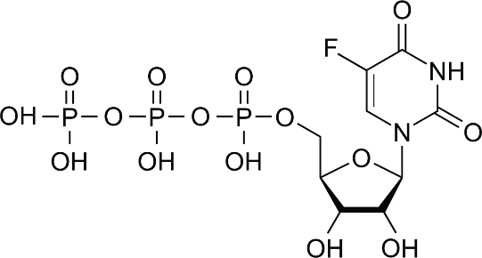
Cell membrane
5-FU
5'DFUR
CH₂THF
DHFU
DPD
FdUMP
FUMP
FUTP
IFNs
LV
MTX
OPRT
PRPP
TP
TS
5-fluorouracil
5’deoxy-5-fluorouridine
5,10-methylene tetrahydrofolate
5,6-dihydro-5-fluorouracil
Dihydropyrimidine dehydrogenase
Fluorodeoxyuridine monophosphate
Fluorouridine monophosphate
Fluorouridine triphosphate
Interferons
Leucovorin
Methotrexate
Orotate phosphorylase
Phosphoribosyl pyrophosphate
Thymidine phosphorylase
Thymidylate synthase
LV
CH₂THF
TS inhibition
Capecitabine
FdUMP
Acute TS induction
Carboxylesterase
Cytidine deaminase
(in the liver)
TP
IFN
DNA
damage
5’DFUR
TP
5’-FU
5’-FU
OPRT
FUMP
FUTP
Uracil
DPD
PRPP
Eniluracil
RNA
damage
Extracellular
Intracellular
MTX
DHFU
Adapted from Longley et al., 2003. AT-UNB-0478

