Slide 1
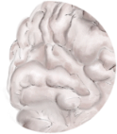
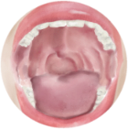
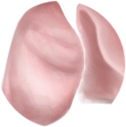
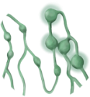
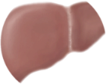
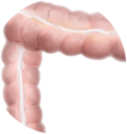
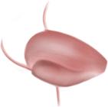
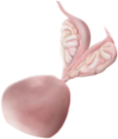
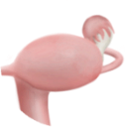
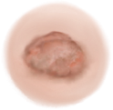
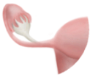
USA 2022
estimated new cases females
31%
estimated new cases males
estimated deaths
25
21%
20
15
13%
15%
10
8%
8%
8%
7%
5
4%
4%
4%
4%
5%
3%
3%
3%
3%
3%
3%
3%
0
brain/NS
oral cavity
esophagus
thyroid
lung
non-hodgkin
lymphoma
breast
liver/bile
pancreas
colon
kidney
bladder
prostate
ovary
uterine corpus
melanoma
skin
leukemia
0
5
3%
4%
4%
4%
4%
3%
4%
4%
4%
6%
5%
6%
6%
10
8%
9%
8%
12%
11%
15
20
21%
25
27%
Quelle: Adapted from Siegel et al.,2022. AT-UNB-0518

