Slide 1
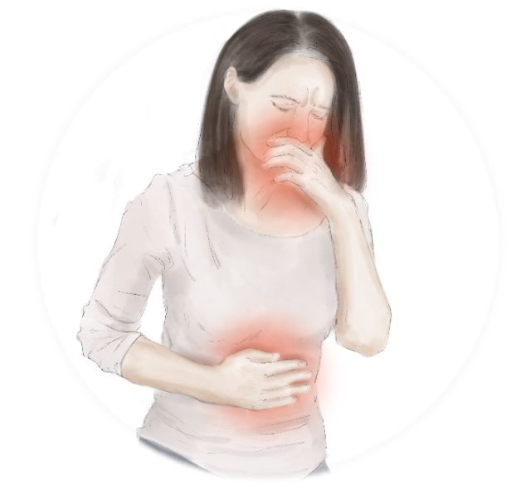
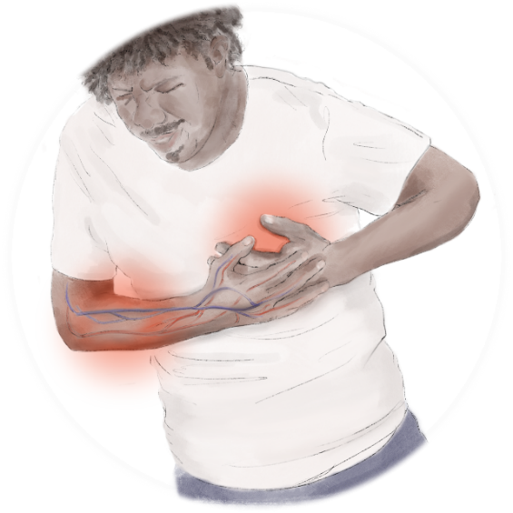
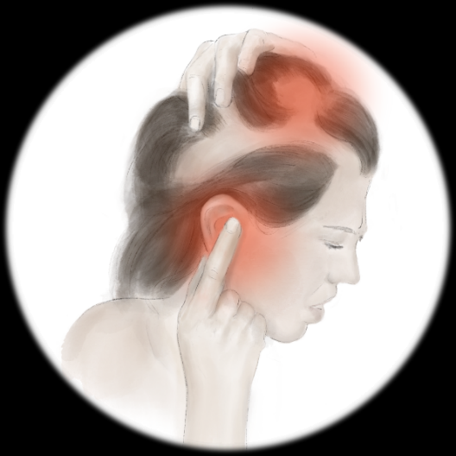
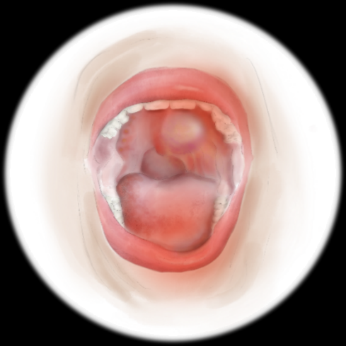
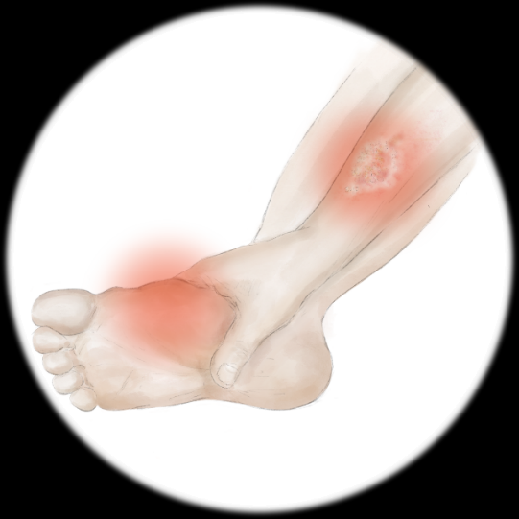
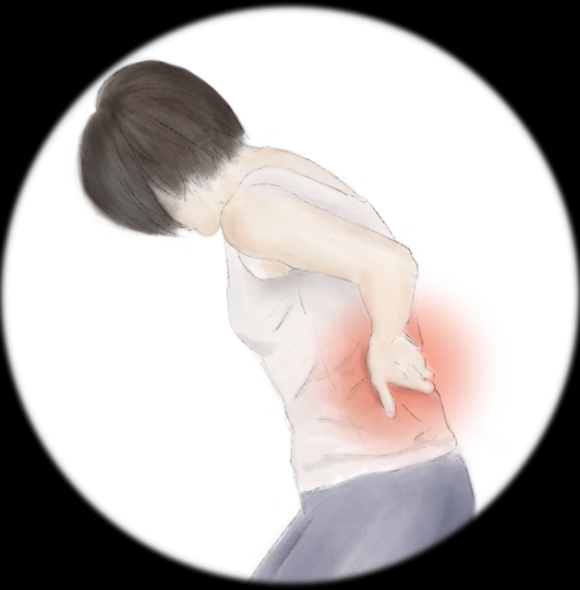
Anorexia
Cyclophosphamide
Alopecia
Anthracyclines
Taxanes
Cardiotoxicity
Anthracyclines
Nausea & Vomiting
Anthracyclines
Taxanes
Hematological toxicity
Anthracyclines
Taxanes
Fluoropyrimidines
Platinum compounds
Gastrointestinal toxicity
Taxanes
Fluoropyrimidines
Ototoxicity
Platinum compounds
Nephrotoxicity
Platinum compounds
Peripheral edema
Gemcitabine
Opportunistic infections
Anthracyclines
Taxanes
Mucositis & stomatitis
Taxanes
Fluoropyrimidines
Platinum compounds
Peripheral neurotoxicity
Taxanes
Platinum compounds
Hand-foot syndrome
Fluoropyrimidines
Quelle: Adapted from Al-Mahayri et al.,2020., Goldschmidt et al.,2018. AT-UNB-0514

