Slide 1
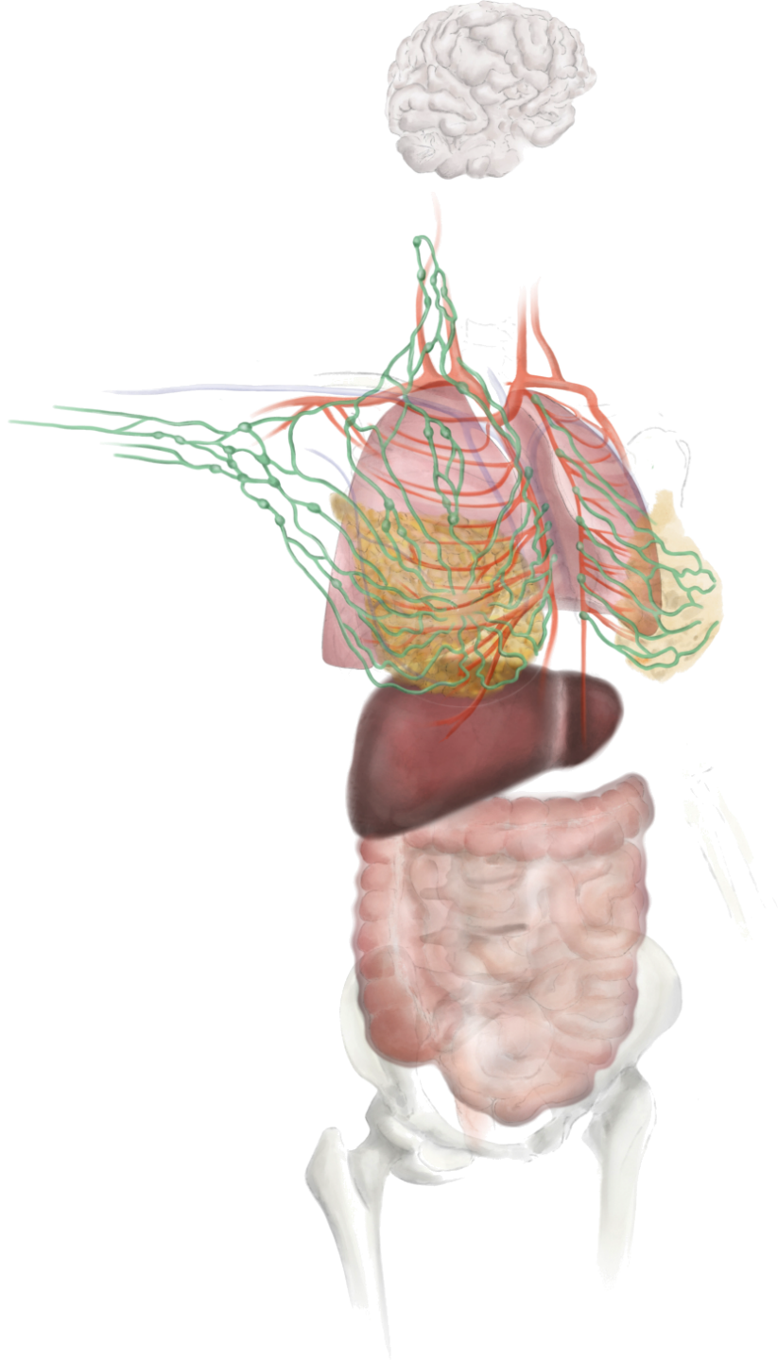
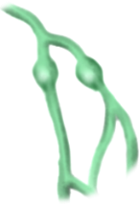
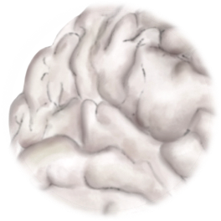
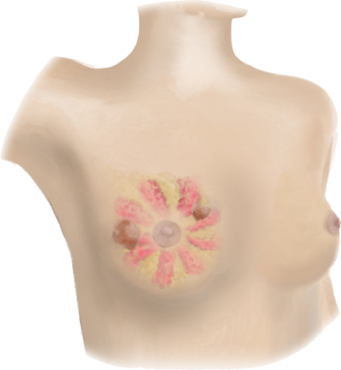
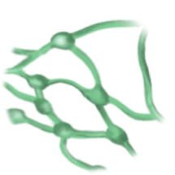
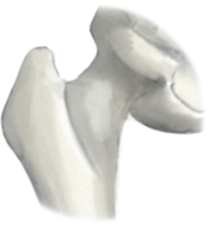
Brain (12.6%)
HER2+ (30%)
Basal-like (25%)
Luminal A (<10%)
Luminal B (10-15%)
Supraclavicular lymph nodes
(1-4%)
Lungs (36.9%)
HER2+ (45%)
Basal-like (35%)
Axillary lymph
nodes (30-50%)
Luminal A-like
Luminal B-like
HER2+
Luminal B (30%)
Luminal A (25%)
Contralateral
breast (6%)
Mammary internal chain lymph nodes (10-40%)
Liver (40.8%)
TNBC and HER2+ more frequent than luminal
HER2+ (45%)
Basal-like (35%)
Luminal A (25%)
Luminal B (30%)
Bone (67%)
Luminal B (79%)
Luminal A (70%)
HER2+ (60%)
Basal-like (40%)
Direct or lymphatic
Haematogenous
Lymphatic
Peritoneum (10%)
Lobular carcinoma
(up to 40% of peritoneal and ovarian metastasis)
Quelle: Adapted from Harbeck et al.,2019. AT-UNB-0513

