Slide 1
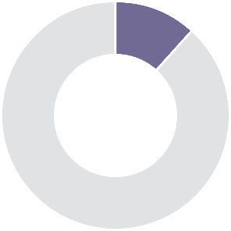
10-15%
13-15%
10-20%
60-70%
Triple-negative
HER2-enriched
(non-luminal)
Luminal B-like HER2+
Luminal B-like HER-
Luminal A-like
Surrogate intrinsic subtypes
(IHC imaging)
ER-, PR-, HER2-; high grade; high Ki67 index; NST histology; special type histology (metaplastic, adenoid cystic, medullary-like and secretory); poor prognosis except for some special cases
ER-, PR-, HER2+; high grade; high Ki67 index; NST histology; aggressive disease but responds to targeted therapies; intermediate prognosis
ER+ but lower ER and PR expression than luminal A-like; HER2+; higher grade; high Ki67 index; NST and pleiomorphic; responds to targeted therapies; intermediate prognosis
ER+ but ER and PR expression lower than in A-like; HER2-; higher grade; high Ki67 index; high-risk GES; NST, micropapillary and lobular pleiomorphic histology; intermediate prognosis
Strongly ER+ and PR+; HER2-; low proliferation rates; typically low grade; low Ki67 index; low-risk GES; NST, tubular cribriform and classic lobular histology; good prognosis
Proliferation
High grade
Basal-like genes
ER expression
Low grade
HER2 expression
Basal A-like
HER2-enriched
Luminal B
Luminal A
TP53 mutations; genetic instability; BRCA mutations; medullary-like histology poorly differentiated
HER2 amplification; GRB7 amplification; PIK3CA mutations; TOPO2 and/or MYC amplification; NST, pleiomorphic lobular and micropapillary histology
PI3KCA mutations (40%); ESR1 mutations (30-40%); ERBB2 and ERBB3 mutations; NST, micropapillary and atypical lobular histology
Activation of ERS1, GATA3, FOXA1, XBP1; NST, tubular cribriform and classic lobular histology
Intrinsic subtypes
( PAM50*)
Claudin-low
Largely triple-negative; metaplastic
* 50-gene signature classifying breast cancer into 5 intrinsic subtypes
Quelle: Adapted from Harbeck et al.,2019. AT-UNB-0516

