Slide 1
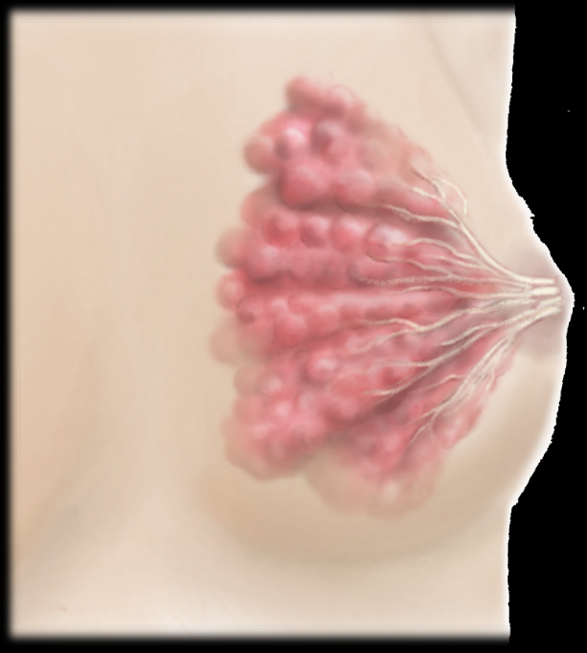
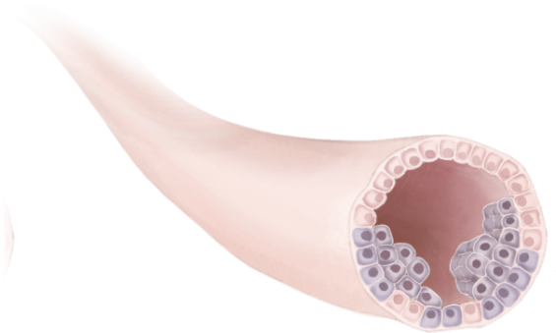
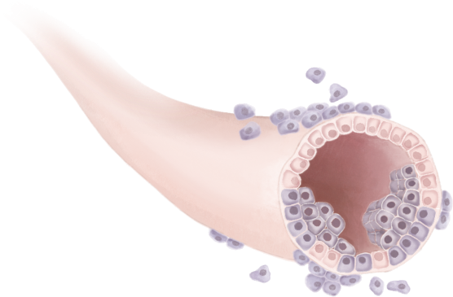
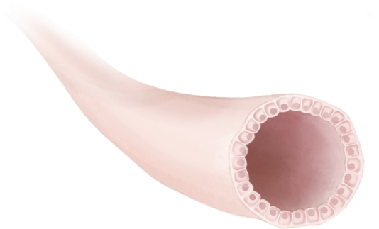
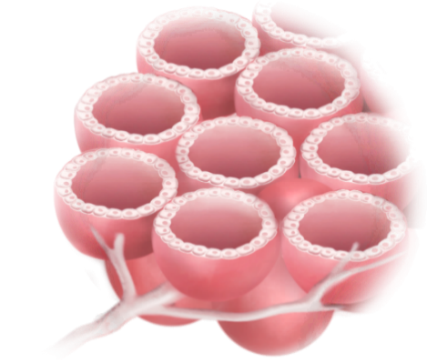
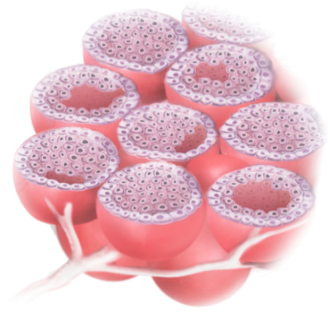
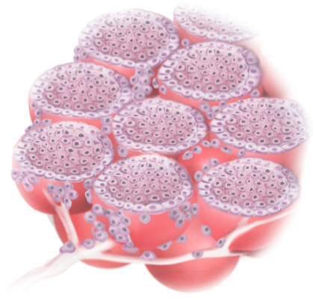
Female breast
Preinvasive
Invasive
Ductal carcinoma in situ (DCIS)
Spreads through ducts and distorts ductal architecture; can progress to invasive cancer; unilateral
Ductal carcinoma no special type (NST)
Develops from DCIS; fibrous response to produce a mass: metastasizes via lymphatics and blood
Collecting duct
Lobular carcinoma in situ (LCIS)
Does not distort ductal architecture; can be bilateral
Risk factor rather than precursor
Invasive lobular carcinoma (ILC)
Isolated tumor cells (CDH1 mutations)
Minimal fibrous response; metastasizes preferentially via viscera
Normal duct
Normal lobule
Quelle: Adapted from Harbeck et al.,2019. AT-UNB-0515

