Slide 1
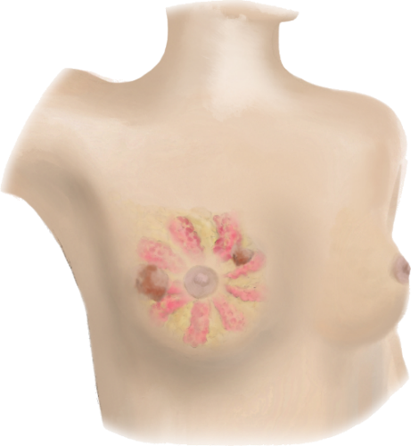
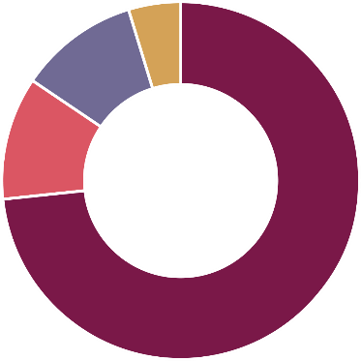
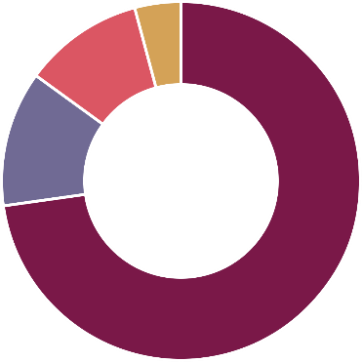
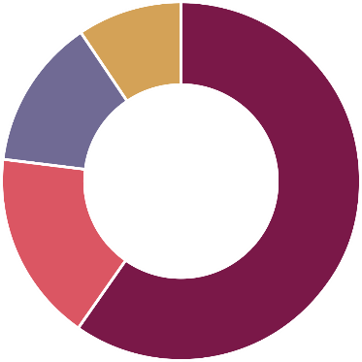
5,5
13,1
13,4
4
88,1
8
11
Age-adjusted incidence rate by subtype in the US (2014-2018)
12
12
Rate per 100.000
15
73
52
HR+/HER2-
HR+/HER2+
HR-/HER2-
HR-/HER2+
Prevalence of clinical subtypes in the US (2012-2016)
HR+/HER2- is the most common subtype of De Novo metastatic cancer
Relative proportion (%)
Patients (%)
Quelle: Adapted from Li et al. 2018, American Cancer Society, National Cancer Institute SEER Program.
AT-UNB-0517

